Slide 1

GREEN OFFICE UPF
ESCRITORIO ACADÊMICO DE SUSTENTABILIDADE

Slide 2

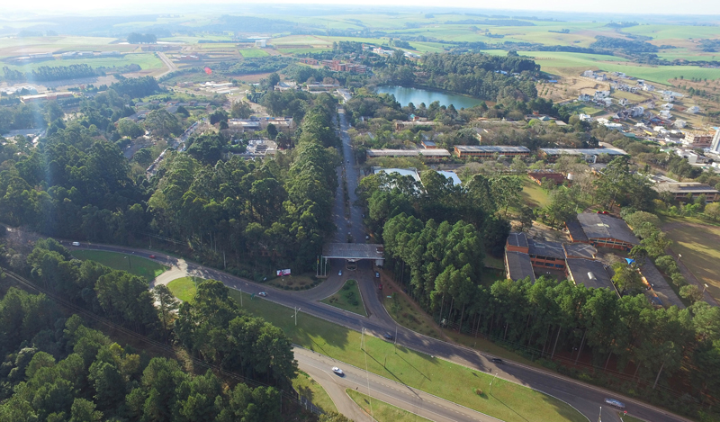


UPF CAMPUS PRINCIPAL - Passo Fundo, Rio Grande do Sul, Brasil
Uma universidade
comunitária
7 Campi
5 Cidades
12000 estudantes
700 professores

Slide 3
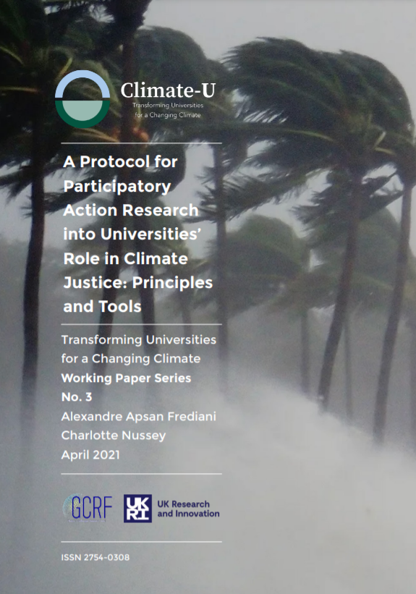
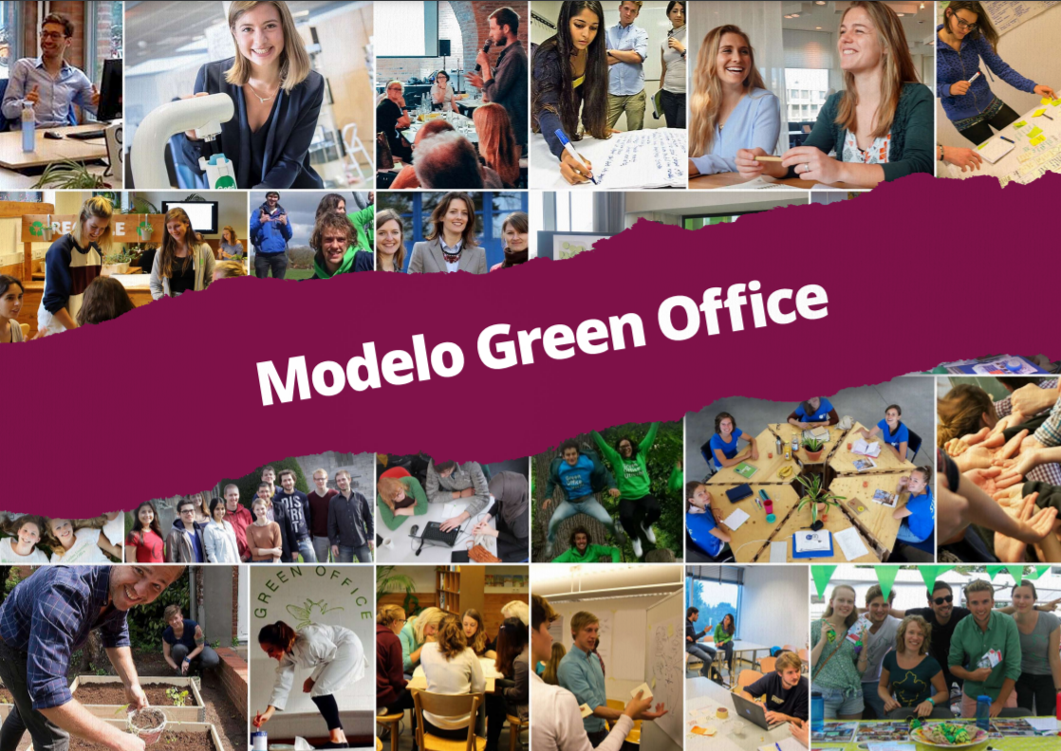
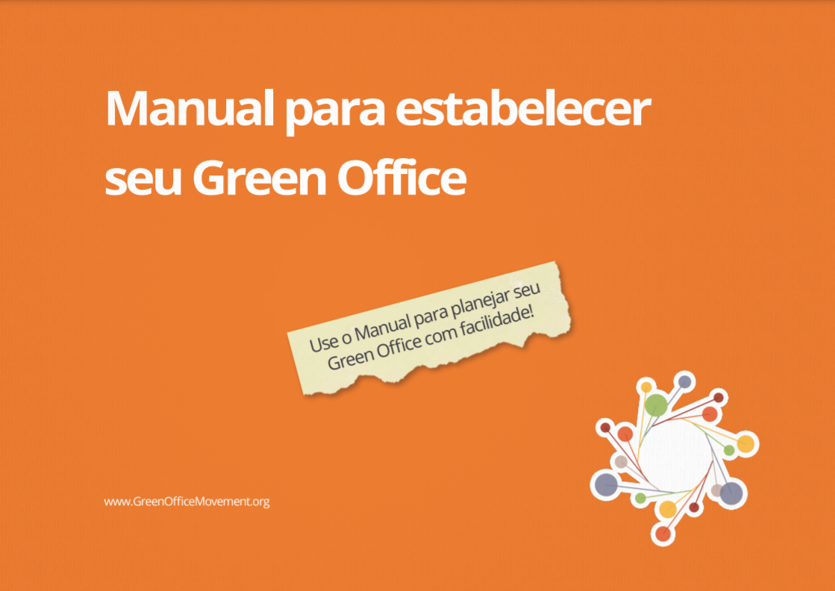
Referencias para a implementação

Slide 4
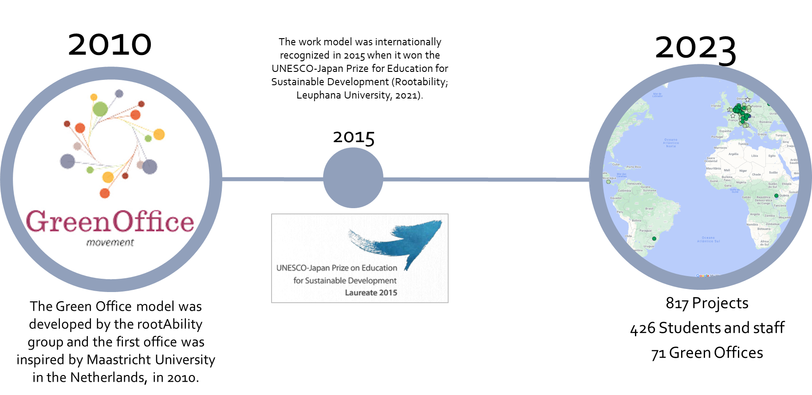

Slide 5
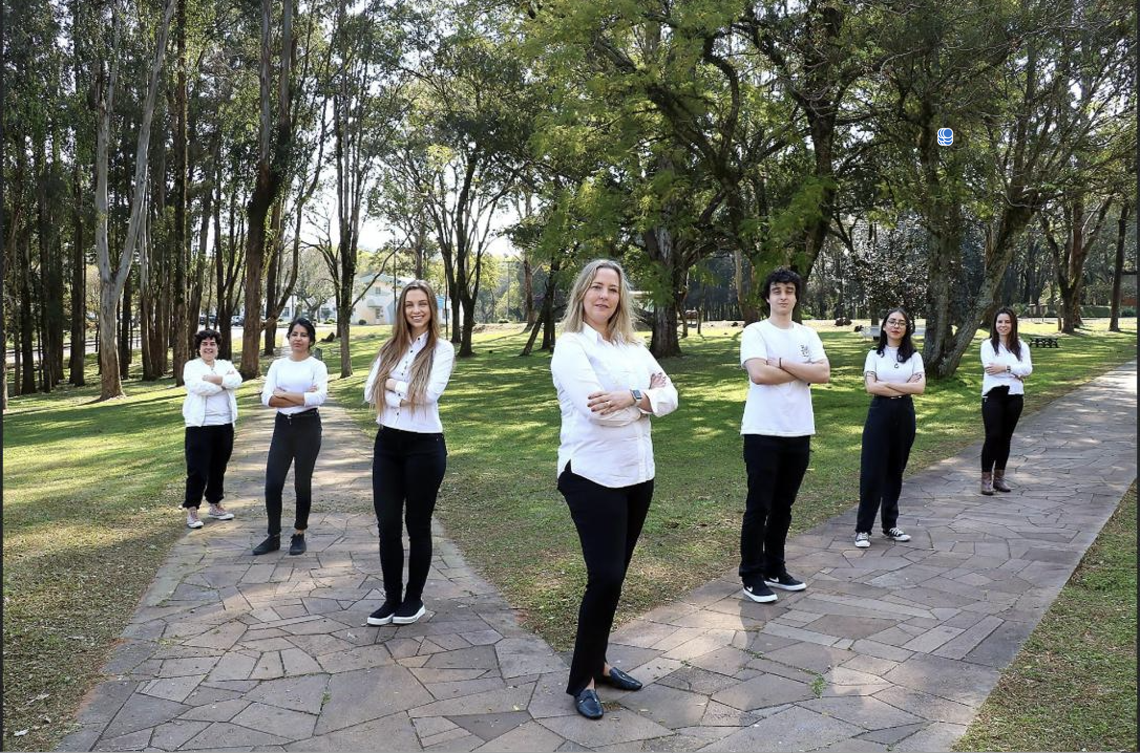
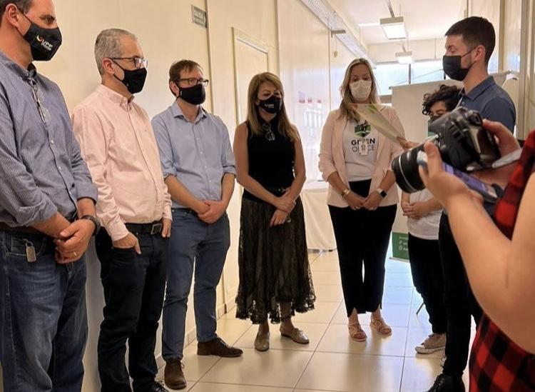
Etapas Importantes
GO logo
Gestão universitária legitima o Green Office como projeto ou departamento oficial por dois a três anos
Definição da equipe - bolsistas

Slide 6
Structure of the Green Office
GO time
Stakeholders
Espaço
Atividades

Slide 7
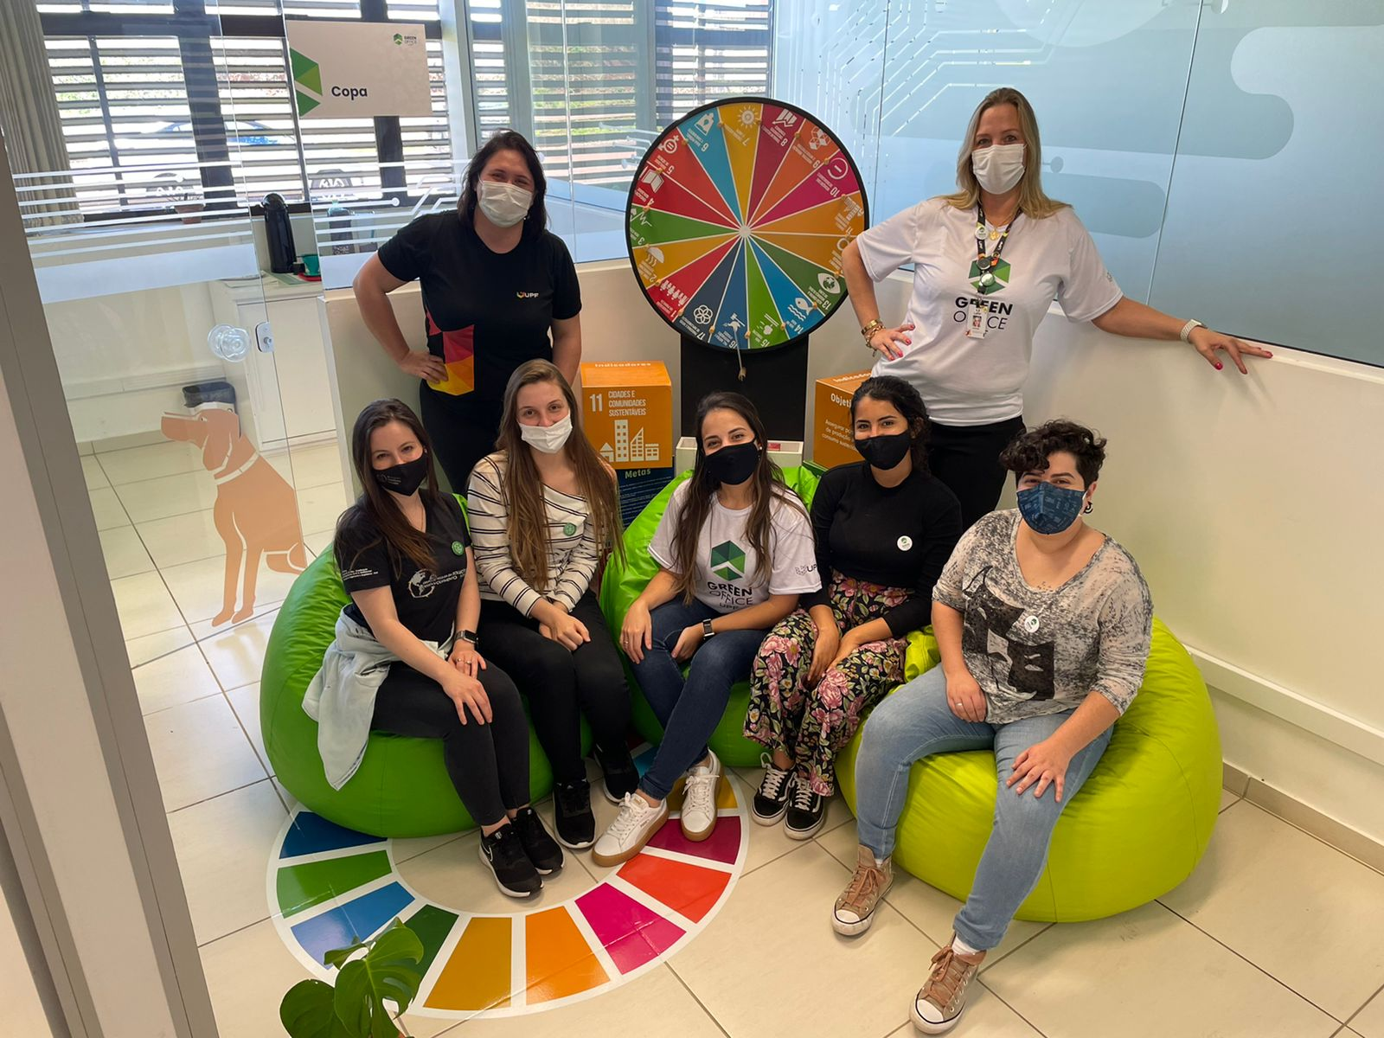
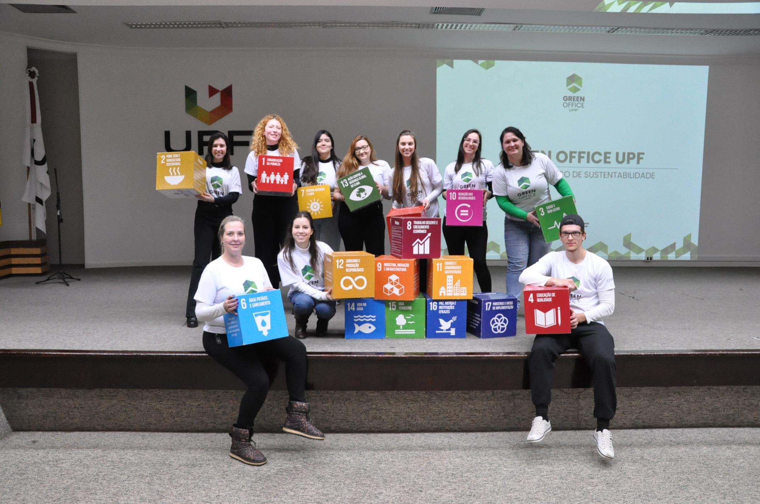
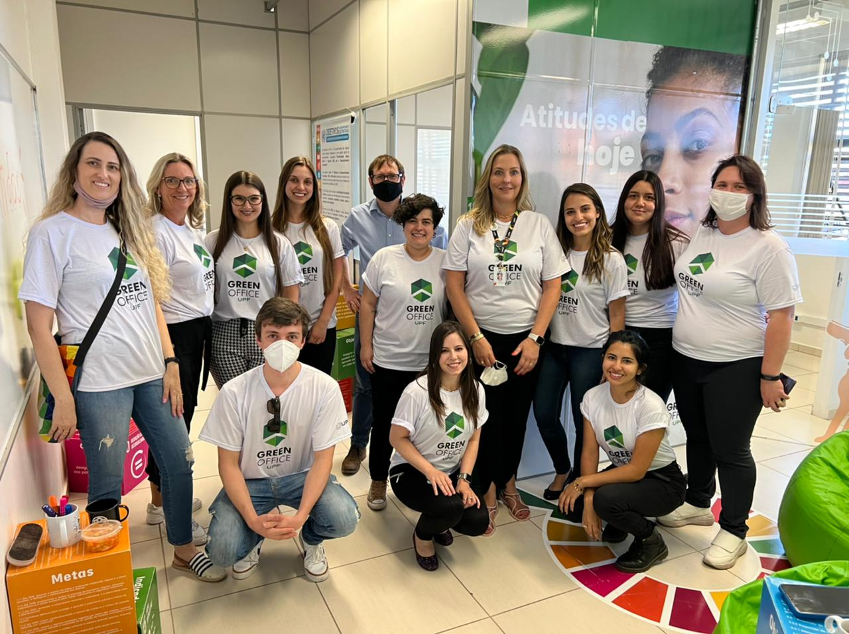
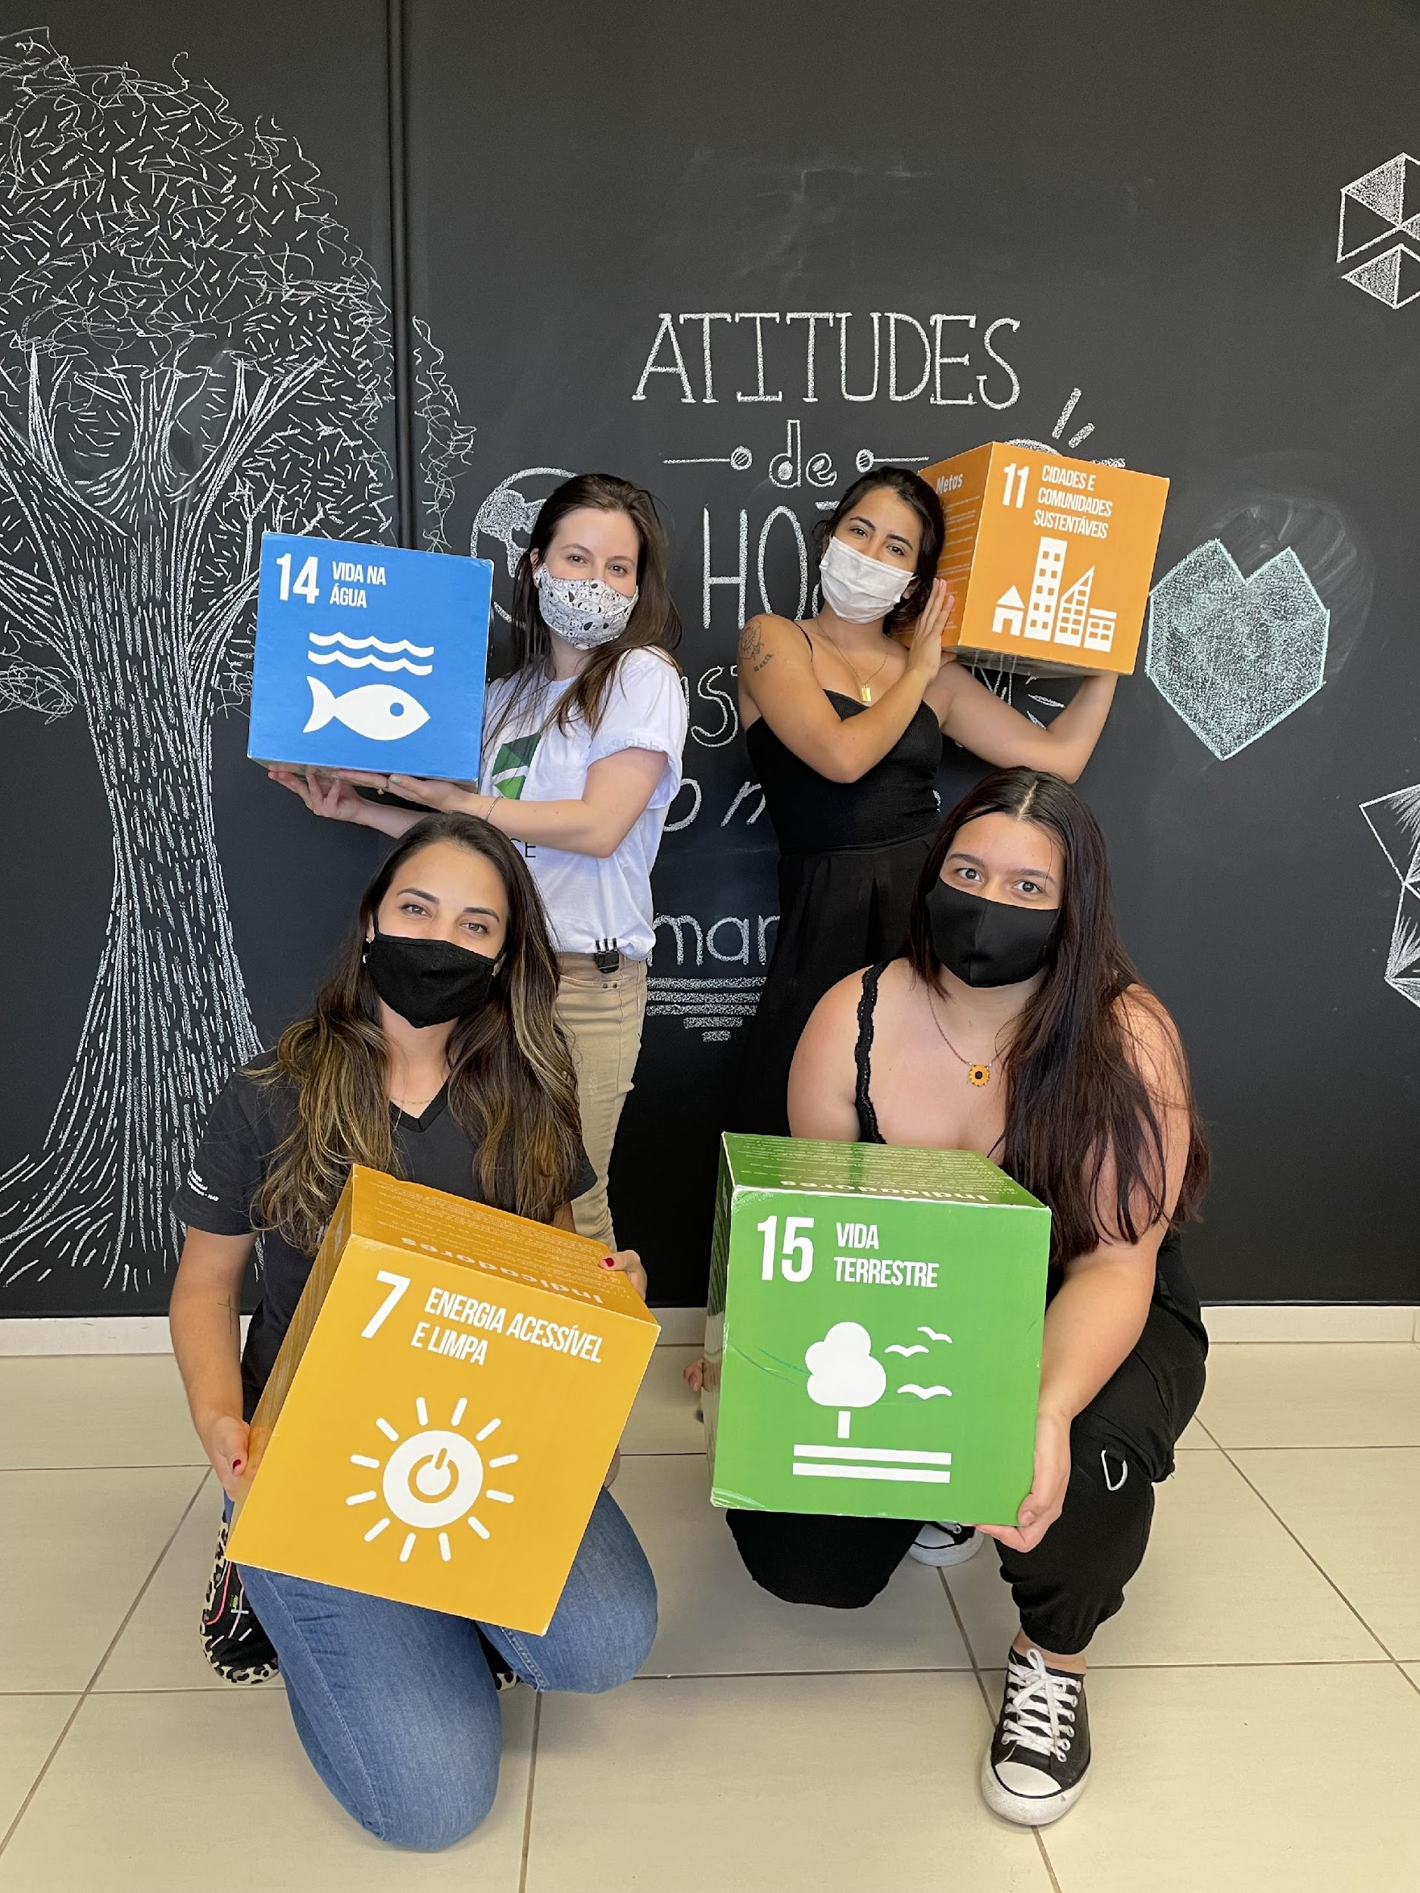
Equipe
GO

Slide 8
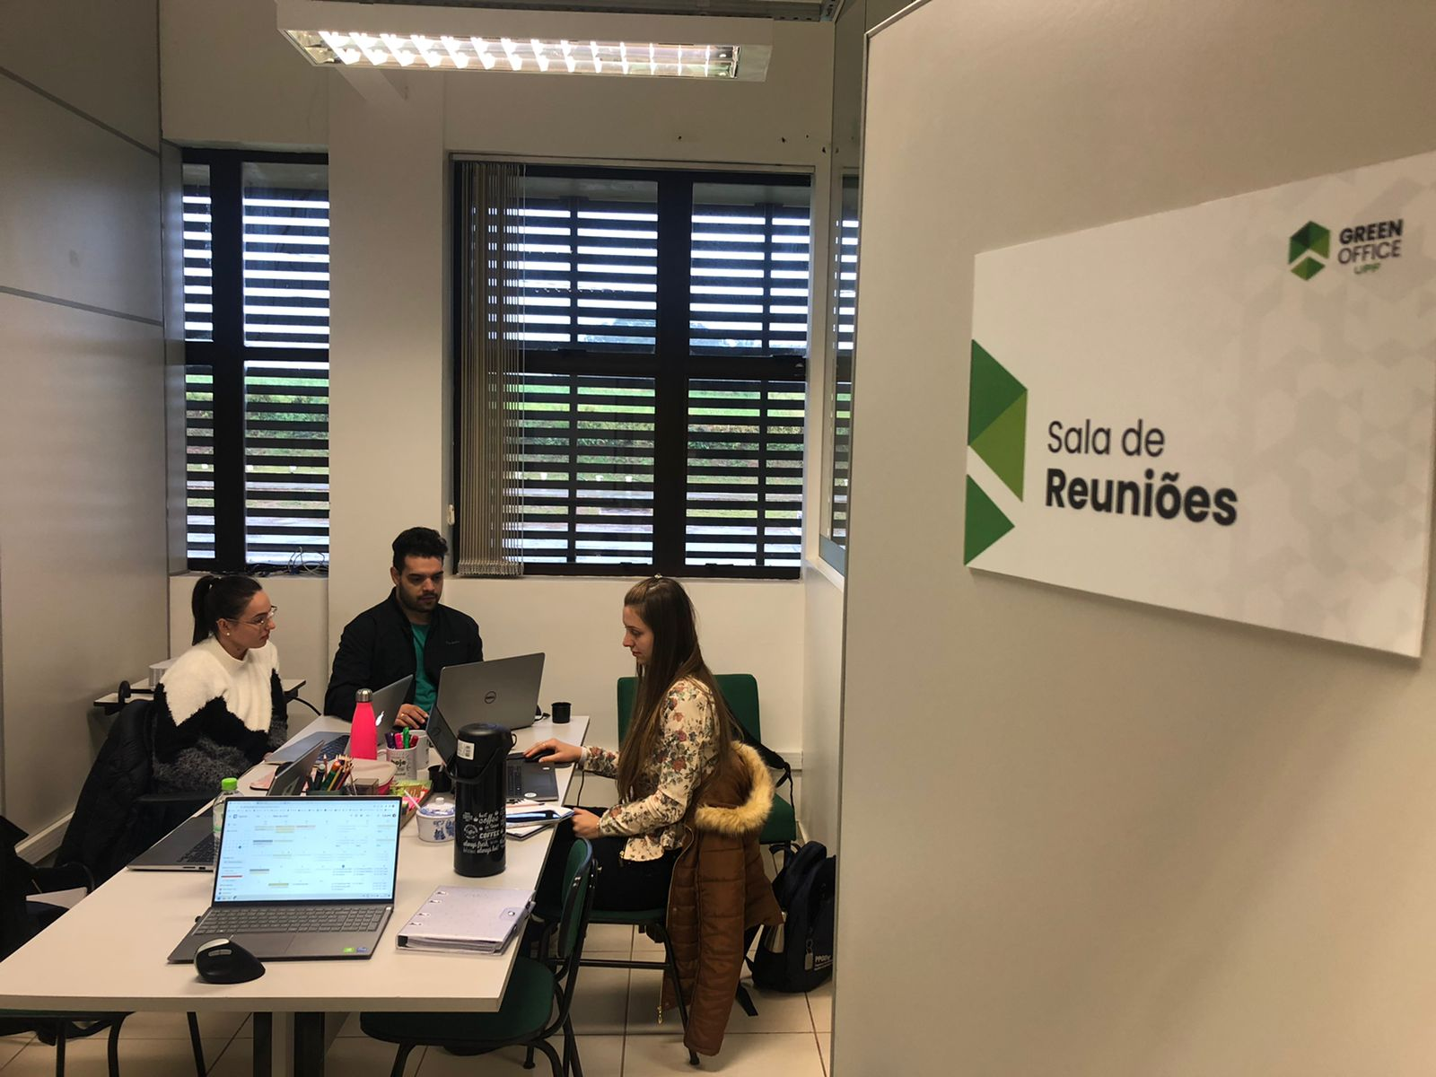
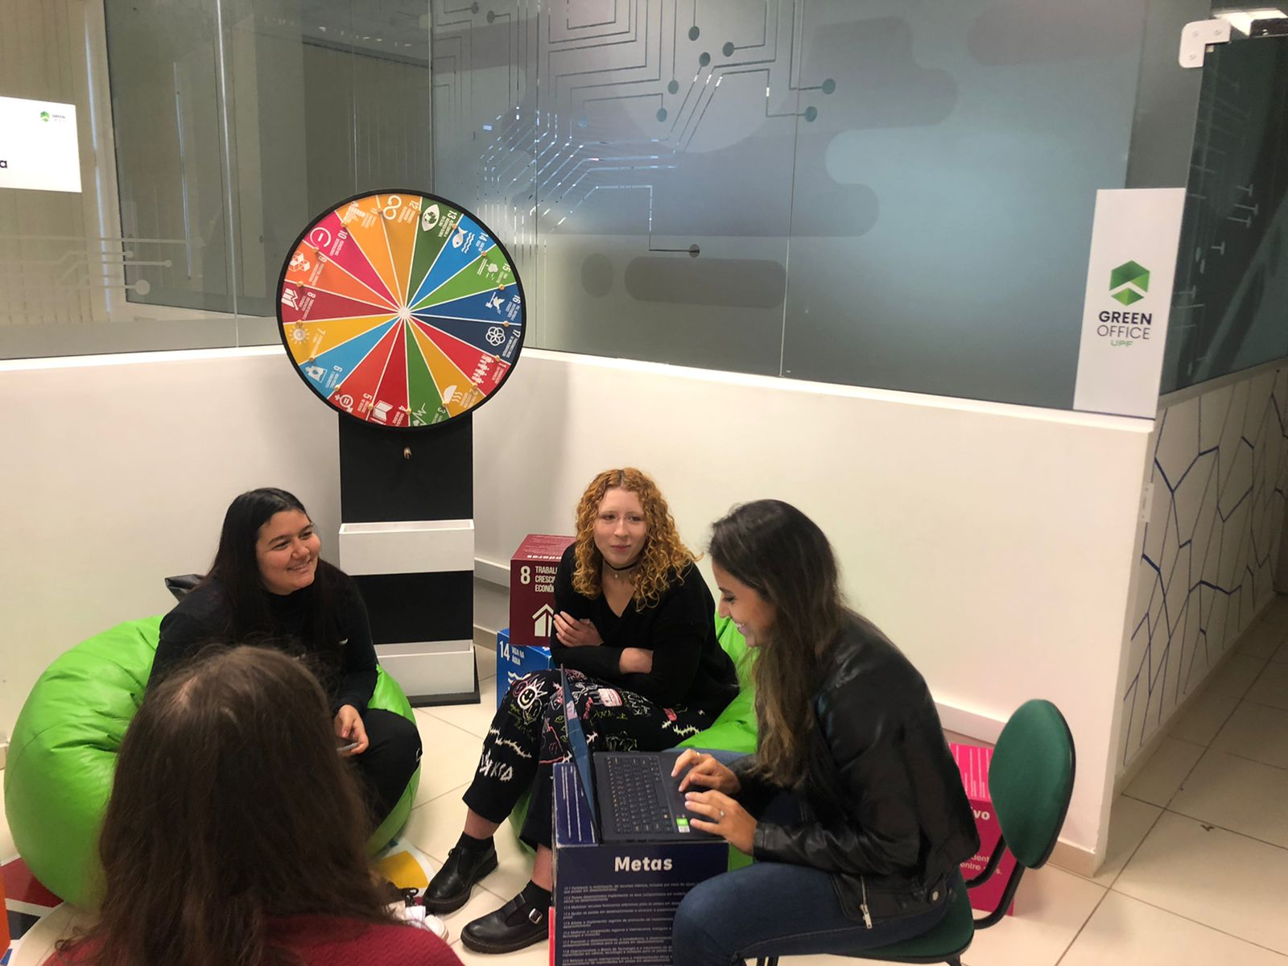
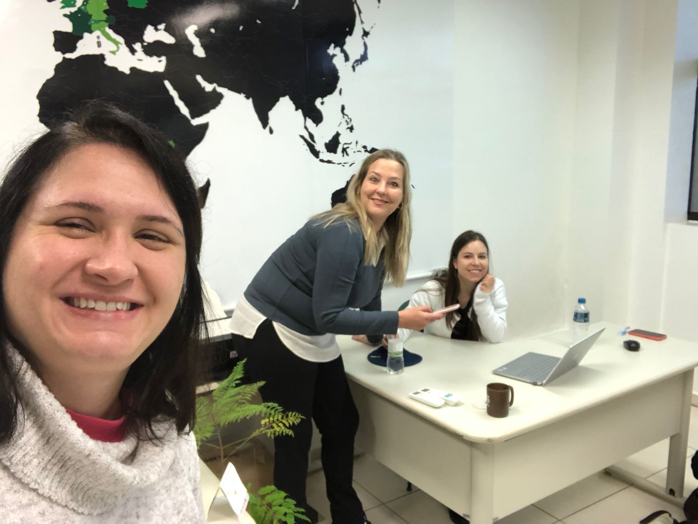
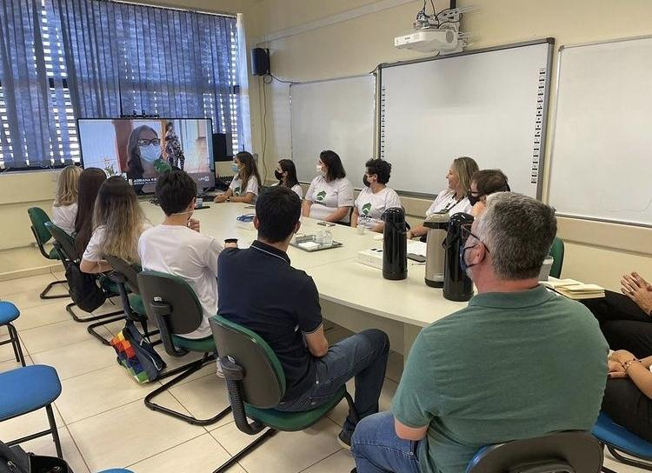
Espaço

Slide 9




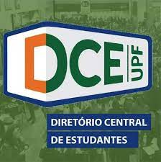







Parceiros - Stakeholders
Vice-Rector of Extension and Community Affairs
Infrastructure and Logistics Division
Cadan Energy Consultancy
Companies/
Local bussiness
Environmental Sanitation Sector
Cielo Environmental Consultancy
Inovate Environment solutions
UPF Central Student Directory
Junior Company - Env. Eng. UPF
Junior Office - Civil Eng. UPF
Municipal Secretary of Education
Municipal Secretary of Environment
Social projects/
NGOs
Municipal Secretary of Urban Planning
Arquitetura para quem mais precisa
Projeto TransformAÇÃO
Notes:
As part of the PAR process, the Green Office also has an alliance with a group of the society to consolidate and implement its activities. This group includes civil society, the public and private sector, and non-governmental organizations.
The involvement of different agents contributes a very important plurality to the multidisciplinary decision-making that the project brings as one of its concepts.

Slide 10
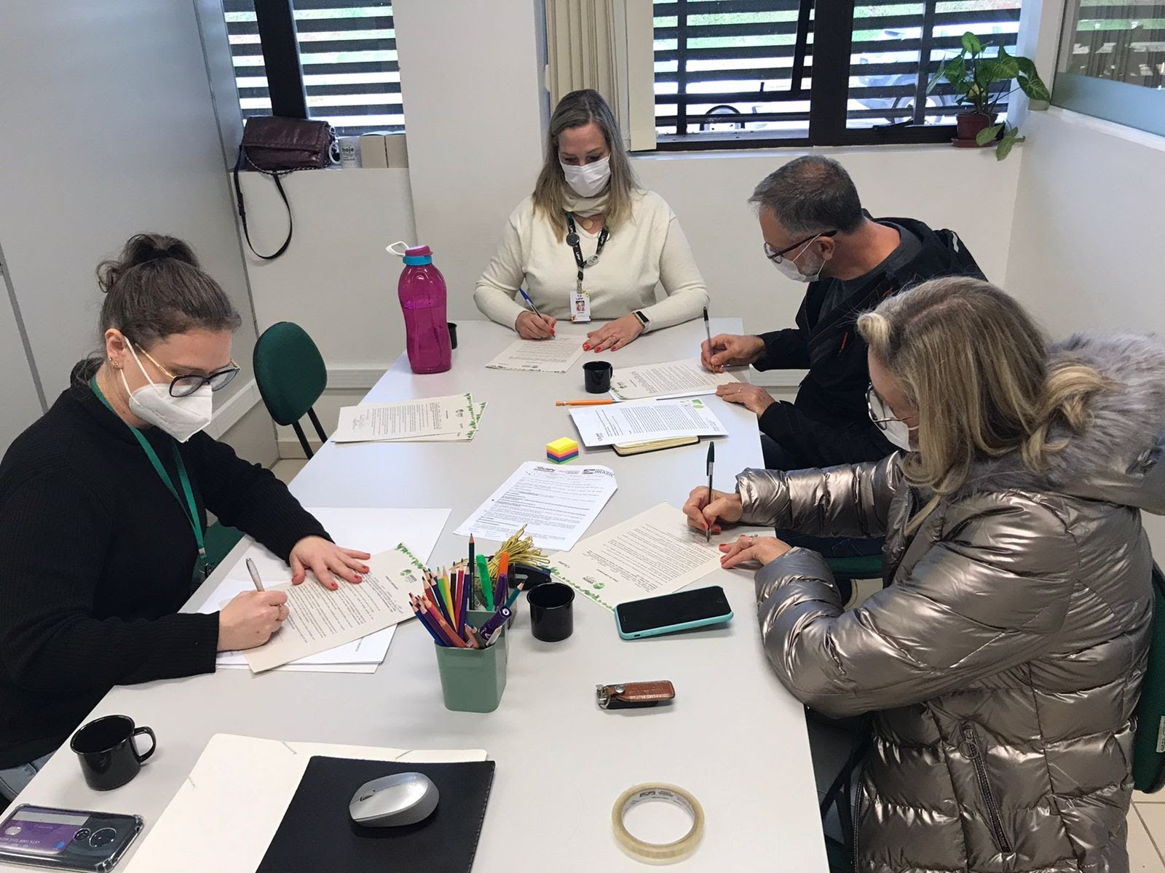
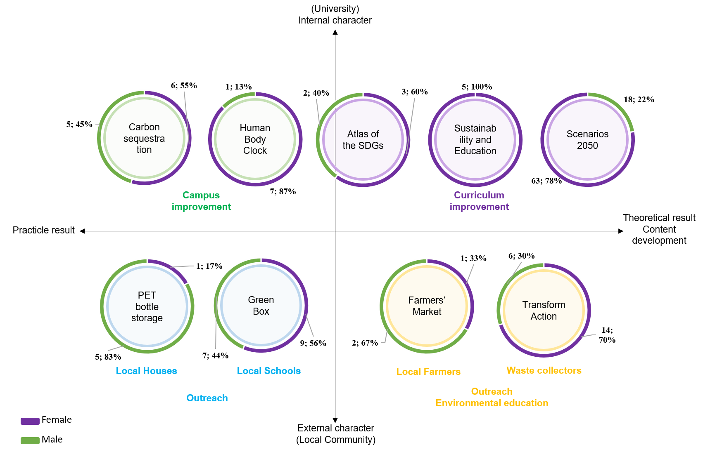
Atividades
O Green Office realizou atividades para informar, conectar e apoiar alunos e funcionários a agir em sustentabilidade.

Slide 11
Projetos
Year | Project | Course/Unit
2021 | Climate Change 2050: The construction of future scenarios by UPF Architecture and Urbanism students | Architecture
 | Environmental Education and Sustainability in Ecological Fairs in the Municipality of Passo Fundo/RS | Environmental Engineering
 | Medical Clock of the Human Body | Graduate Program in Civil and Environmental Engineering
2022 | Game Path of Transformation | UPF Cell and Project TransformAção
 | ECOBLUE: PET bottle storage | Course in Administration, Accounting Sciences, Economic Sciences and International Trade at UPF
 | Impact of UPF Graduate Studies on the SDGs | Graduate Program in Civil and Environmental Engineering
 | Carbon sequestration with Strategic Native Trees for Wild Fauna | Wild Fauna Management Laboratory
 | Sustainability and Education: actions that change the planet | Law
2023 | Go by bike with the Green Office | Graduate Program in Civil and Environmental Engineering
 | Competition Giant Trees of Rio Grande do Sul | Institute of Health and School of Agricultural Sciences, Innovation and Business
 | Promoting Food Safety and Improving the Nutrition of Waste Recyclers | Nutrition
 | Teaching-research-extension helping in the organic conversion of a university vegetable garden: formation, perceptions and experiences of sustainability | Agronomy and Graduate Program in Agronomy
 | (RE)ACT!: a project about consumption, environment and society | Languages

Slide 12
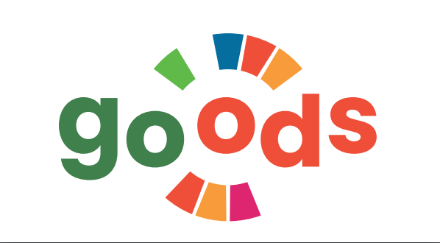
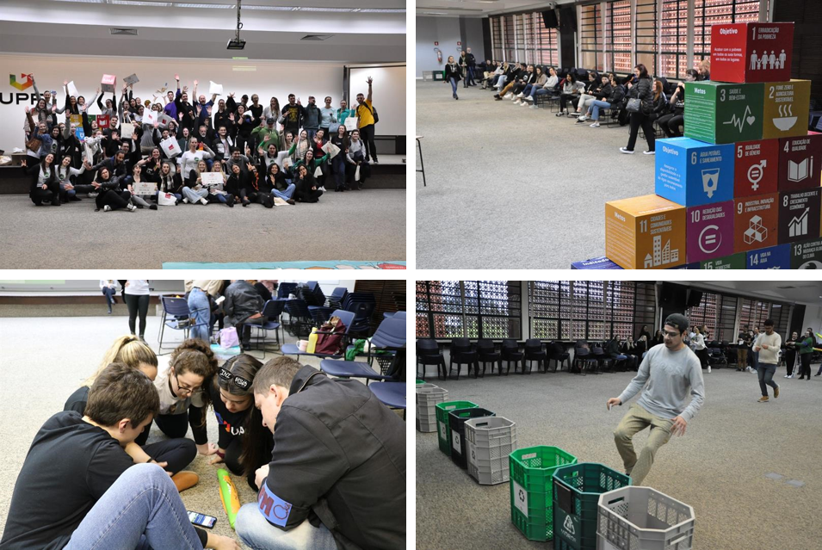
Gincana ODS
Com o objetivo de promover o aprendizado de forma ativa, o jogo Caça ao Tesouro sobre os ODS criou um espaço de conhecimento e engajamento coletivo sobre sustentabilidade e ação climática na universidade. Esta foi a primeira edição e mobilizou 75 participantes de diferentes formações.

Slide 13
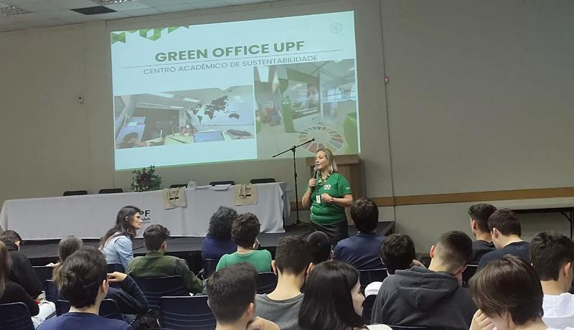
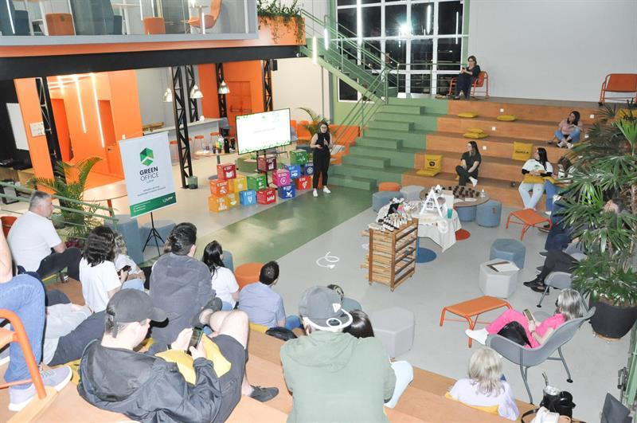
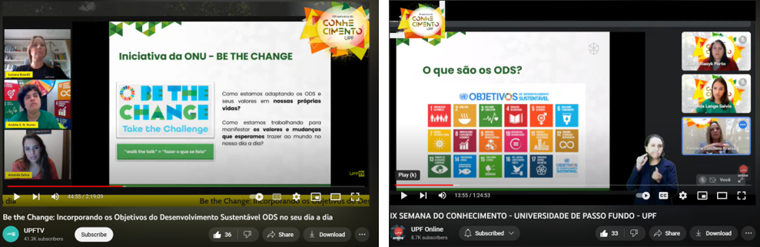
Palestras e workshops para alunos do ensino médio, graduação e pós-graduação
Palestra na “Semana do Conhecimento Integrado no Ensino Médio”.
Workshop sobre Mudanças Climáticas e Empreendedorismo Sustentável.
"Be the Change" workshops (2021 e 2022).

Slide 14
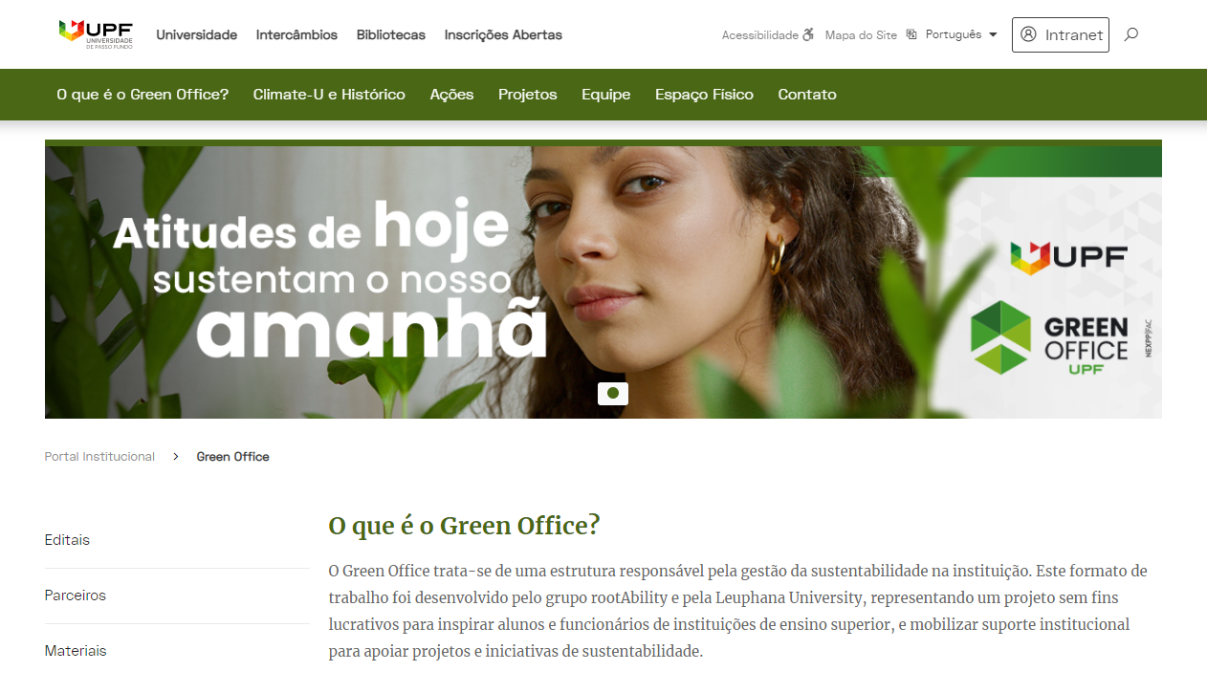
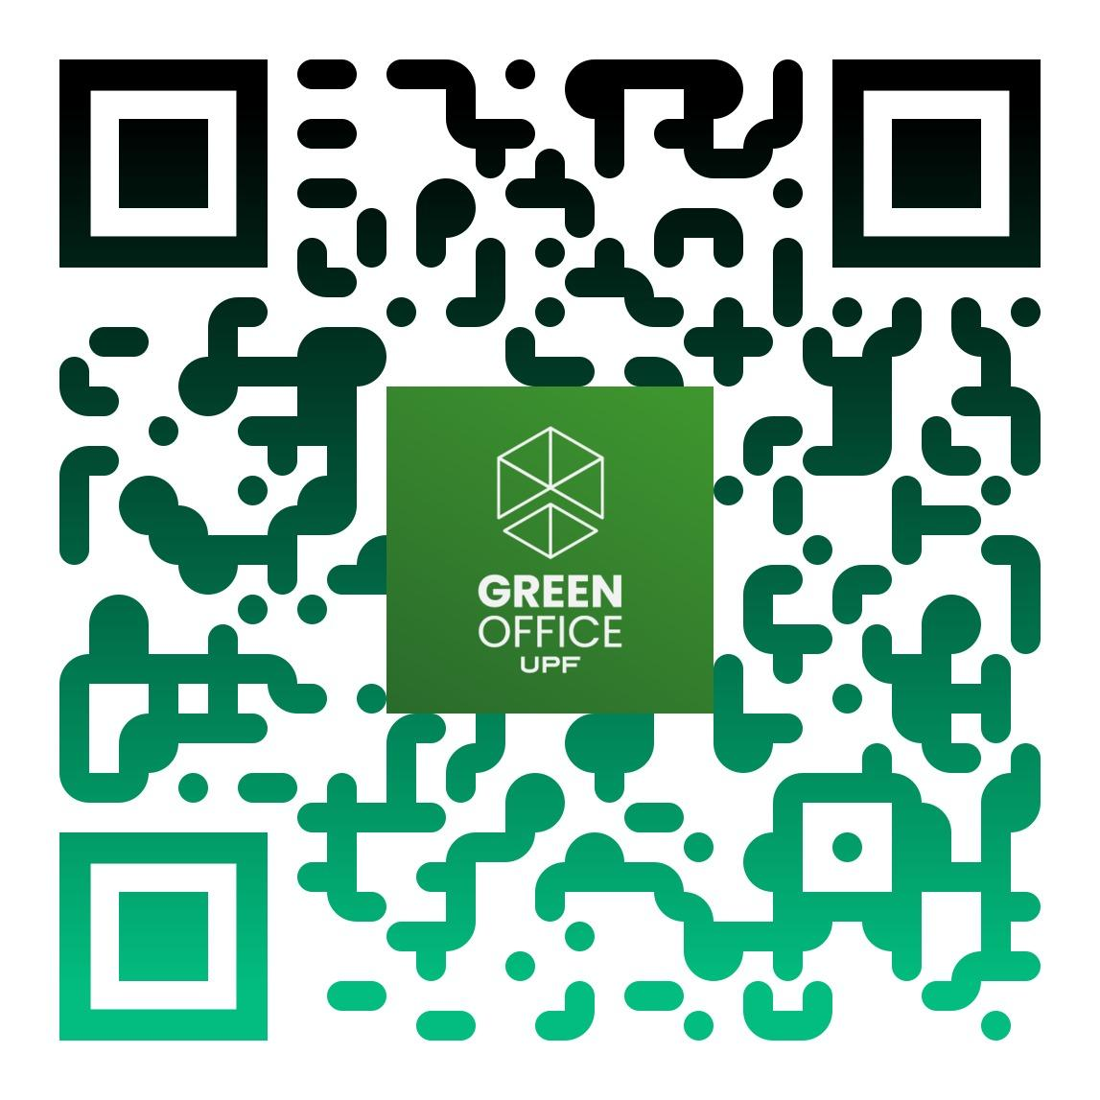
Website
www.upf.br/greenoffice

Slide 15
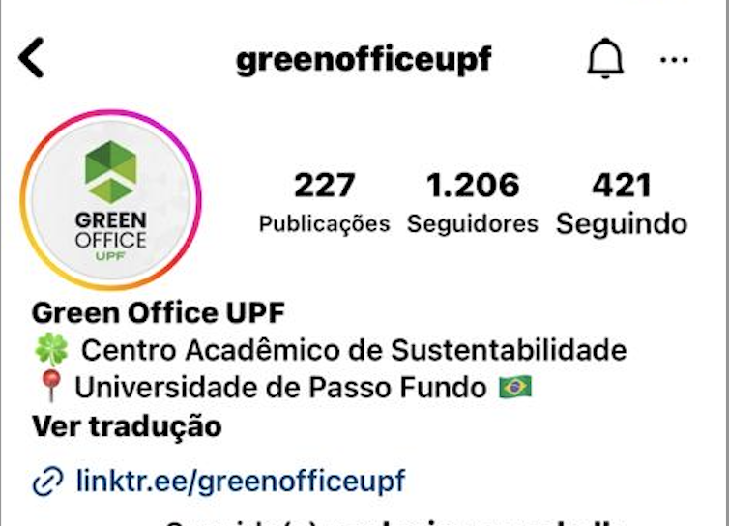
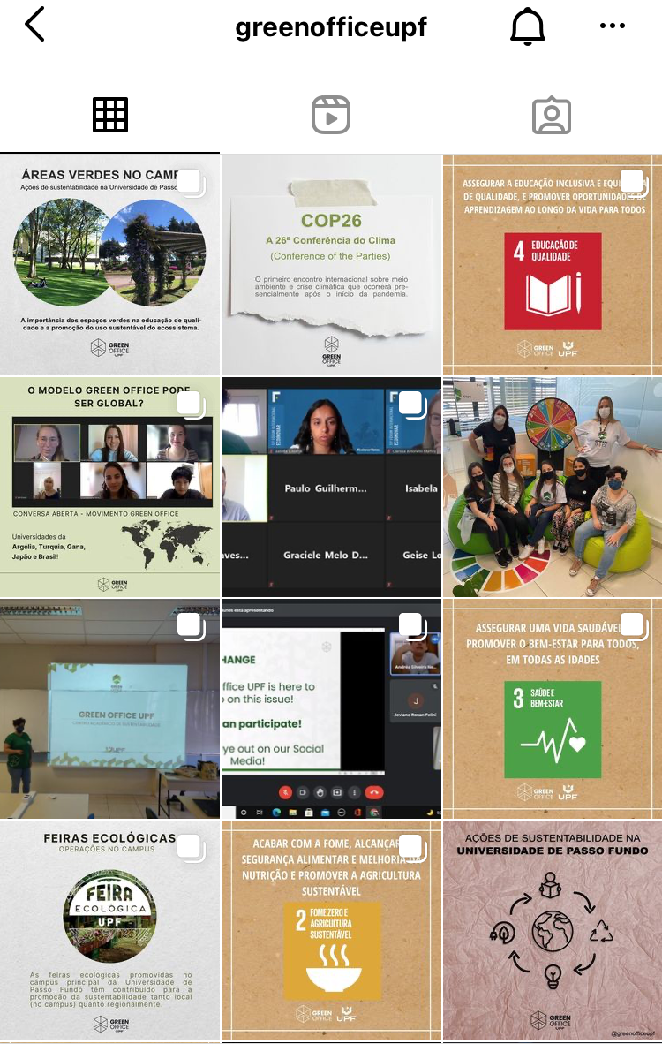
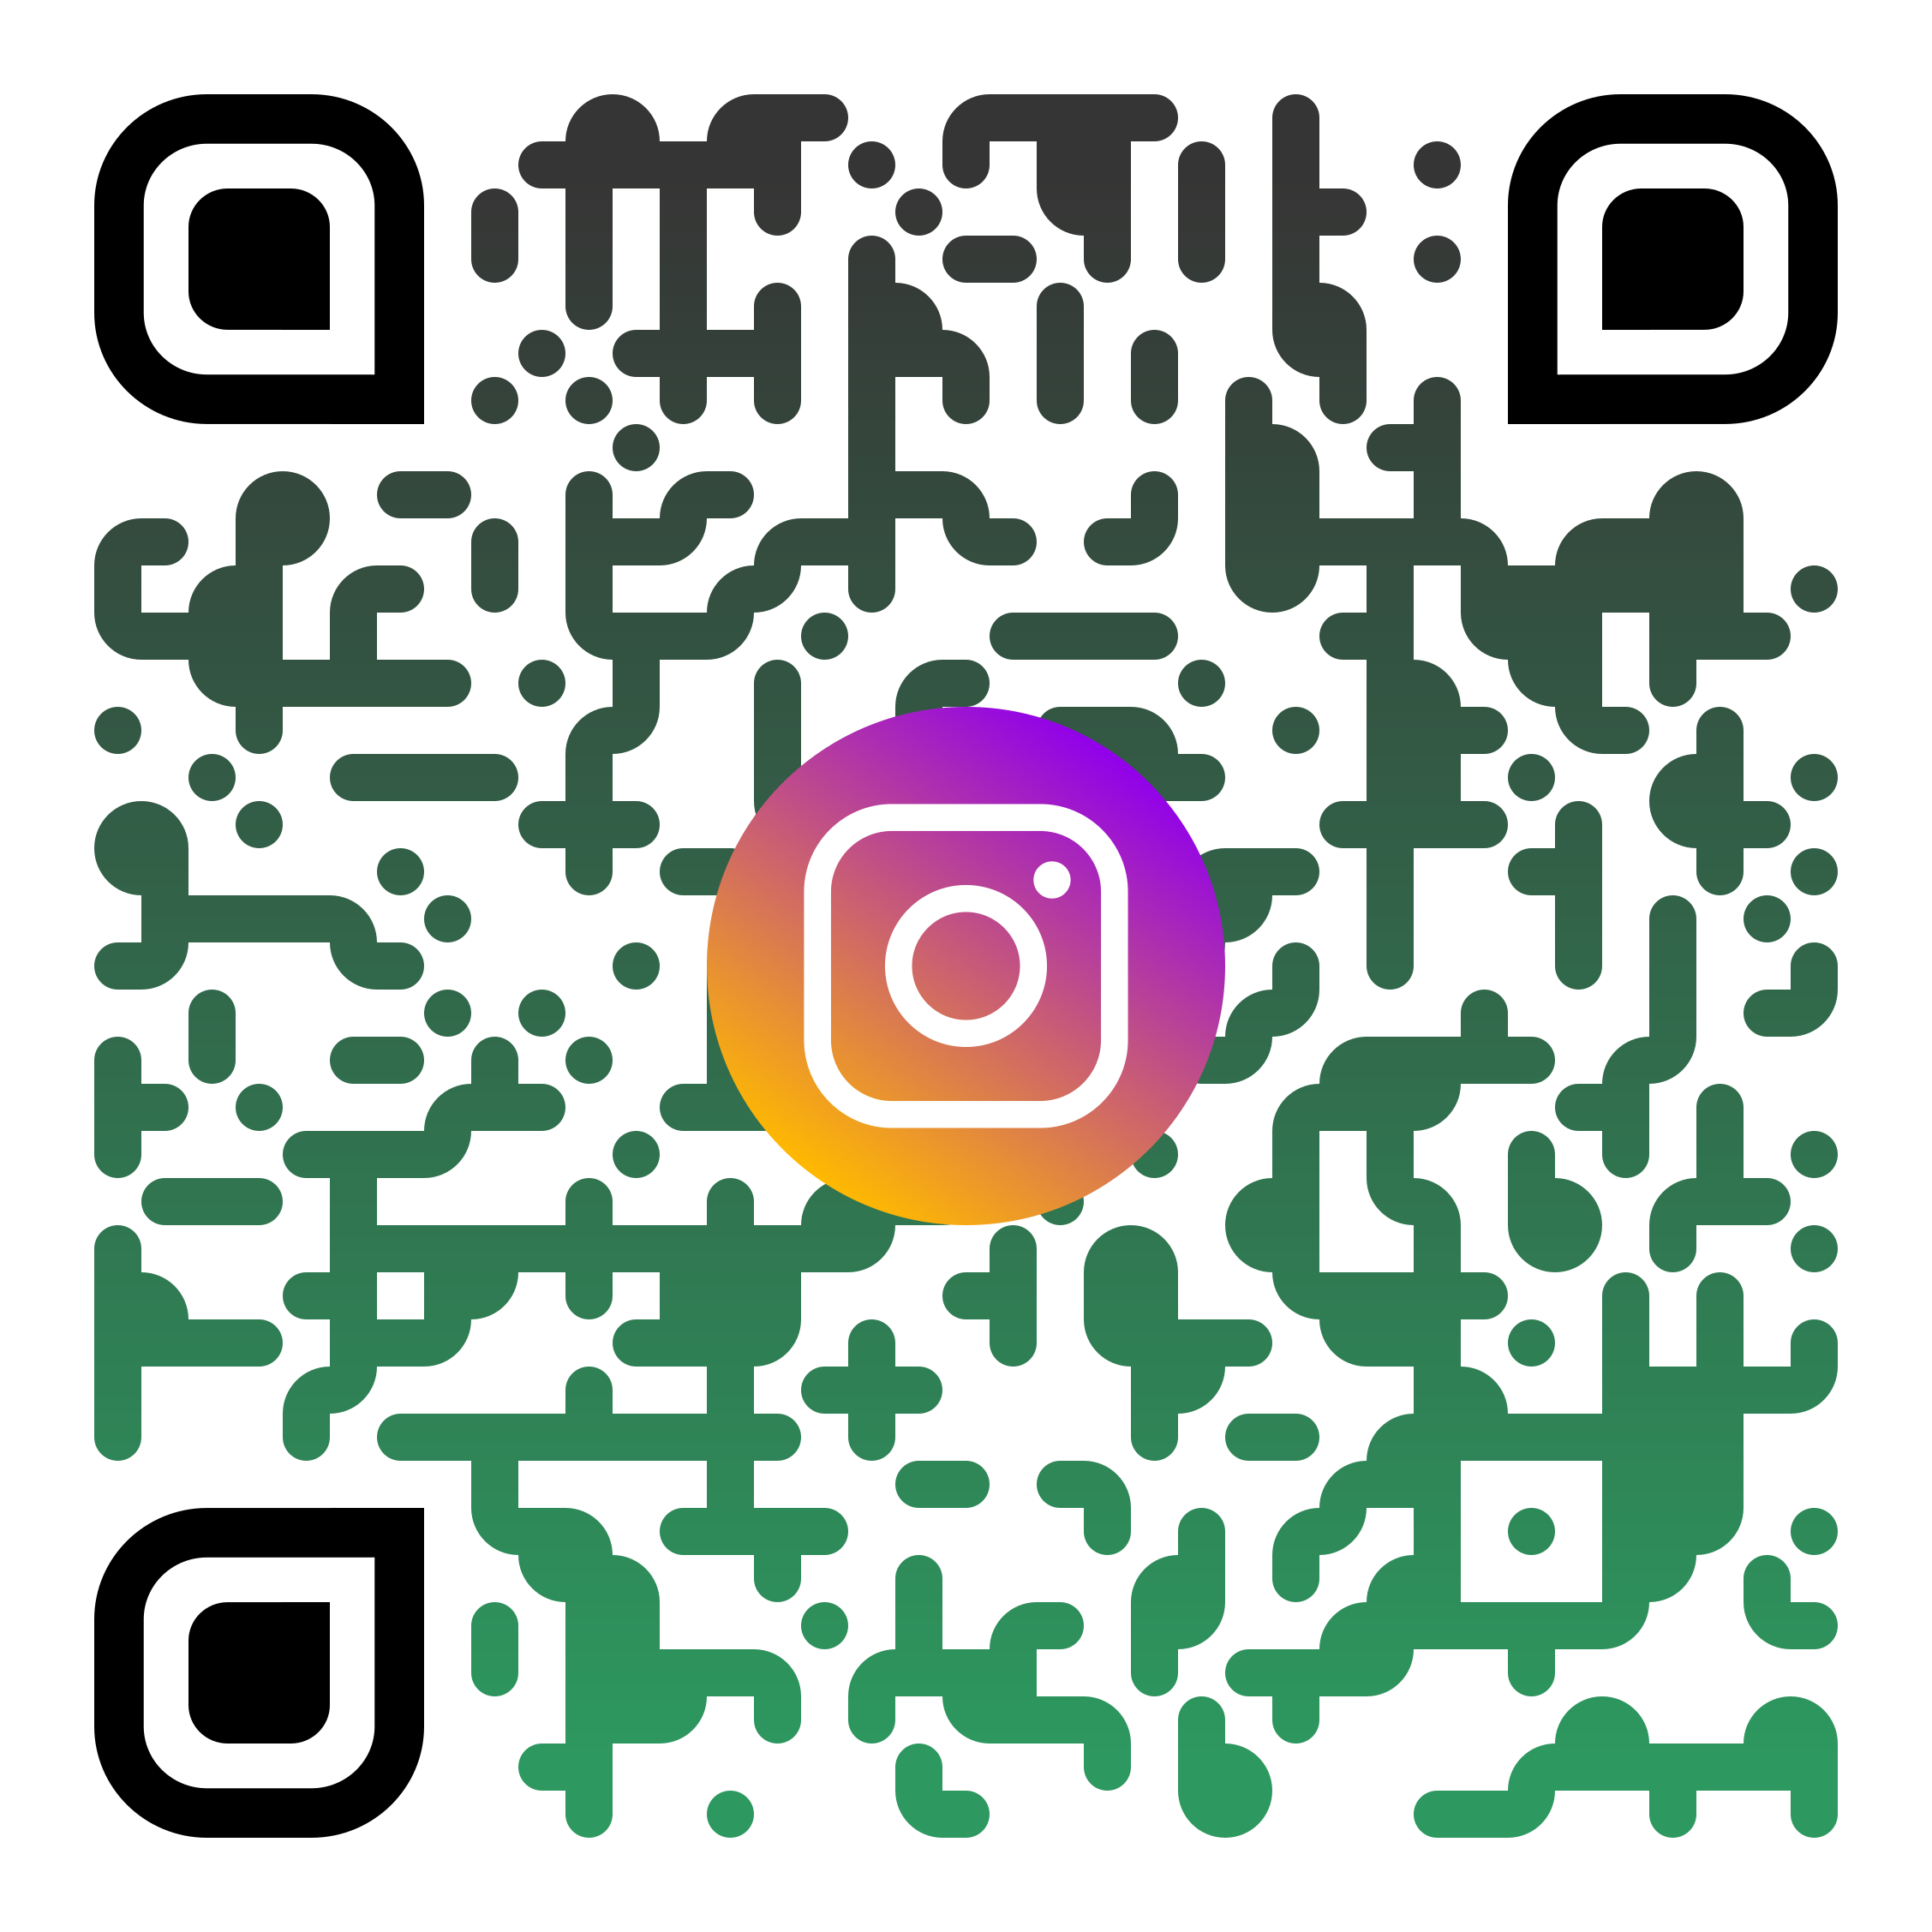
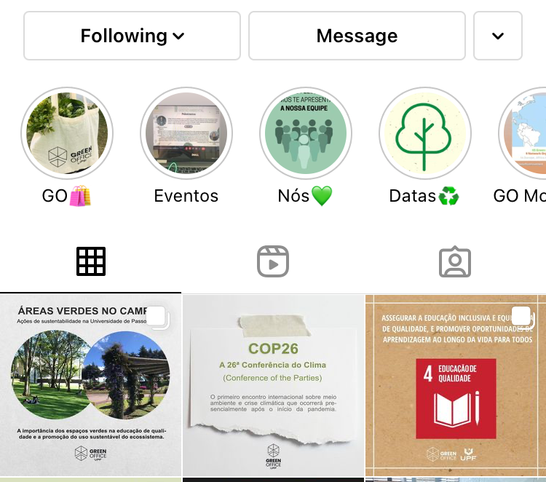
Redes Sociais
@GreenOfficeUPF

Slide 16
Obrigada

