Slide 1
Climate-U
Transforming Universities for a Changing Climate
Tristan McCowan (UCL)
12th June 2023

Slide 2
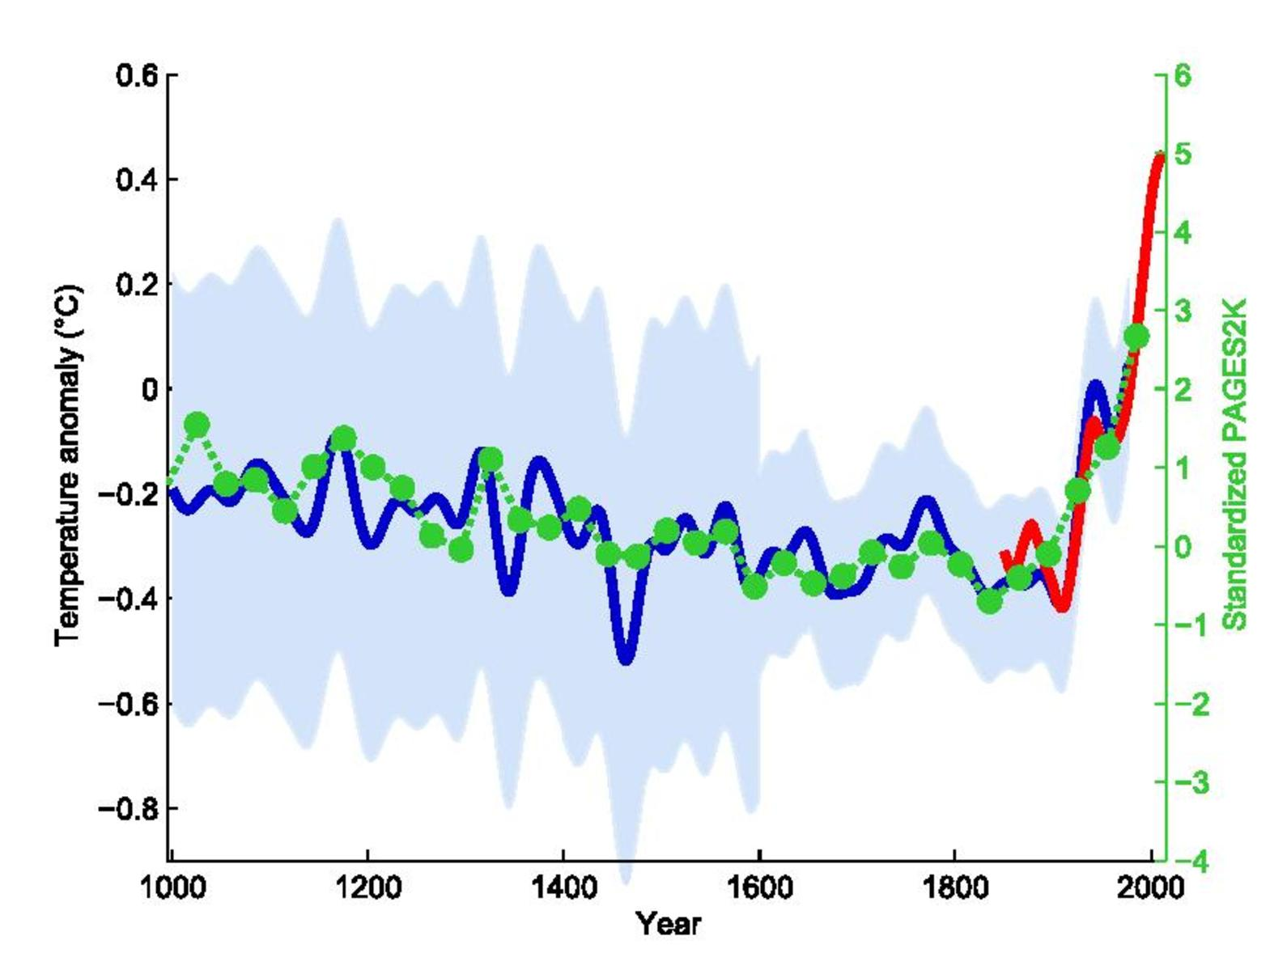
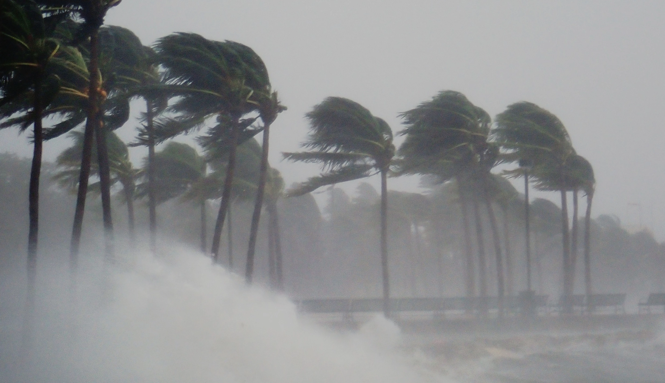
(Mann, Bradley & Hughes 1999)

Slide 3





Trajectories of Impact
University
Bridging
Actors
Society
Ecosphere
Education
Knowledge production
Graduates
Interaction
Service delivery
Organisations
Economic, political, & cultural spheres
Climate change
Public debate
Communities
Campus operations
Feedback loops

Slide 5
